Slide 1
Backpropagation Step by Step

Slide 2
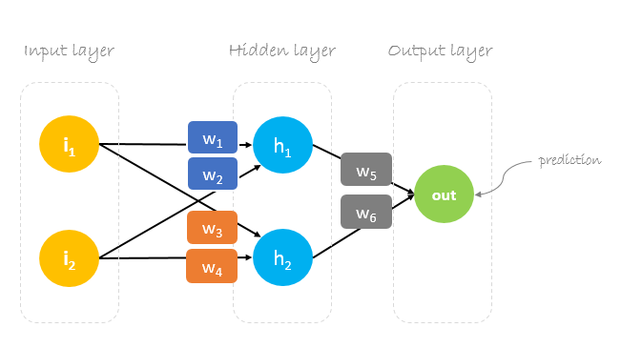
Purpose: to effectively train a neural network by way of cycles through a differentiation method called the chain rule.

Slide 3
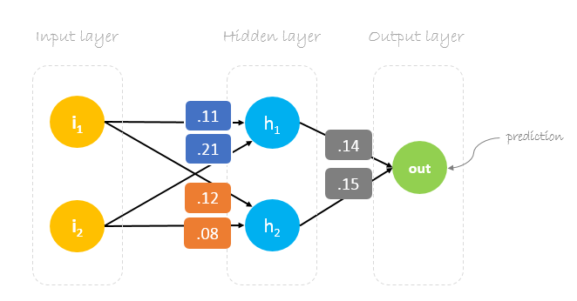
Our initial weights will be the following:
w1 = 0.11
w2 = 0.21
w3 = 0.12
w4 = 0.08
w5 = 0.14
w6 = 0.15
Goal: to optimize our weights so our neural network model can learn how to correctly map arbitrary inputs to outputs

Slide 4
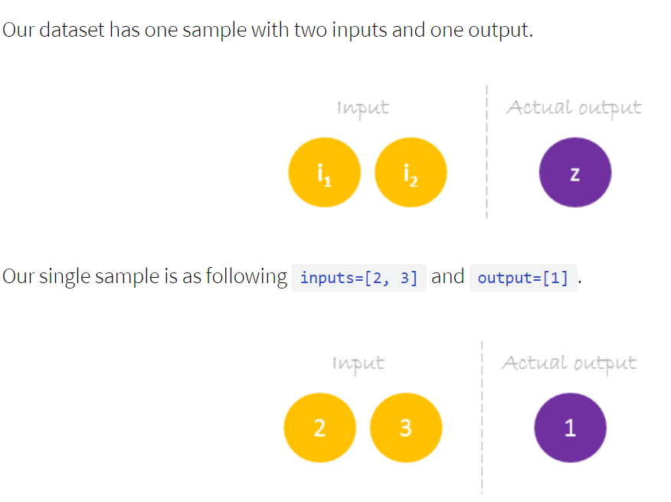

Slide 5
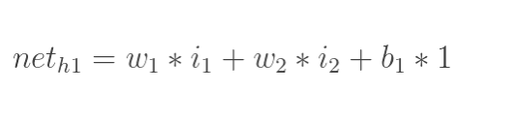
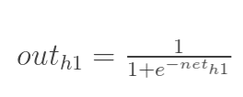
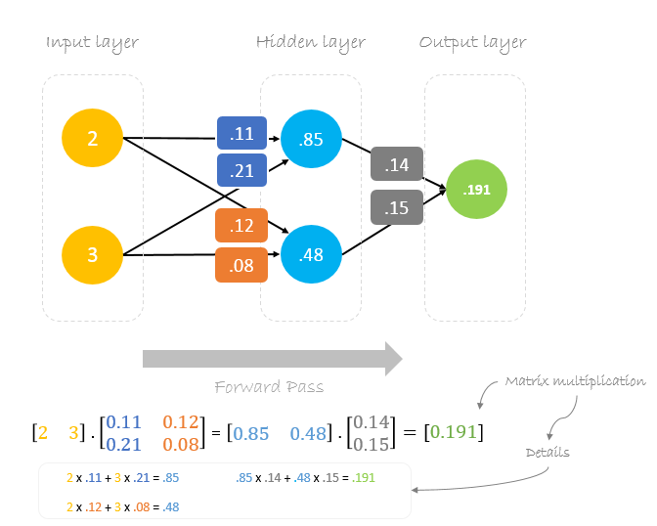
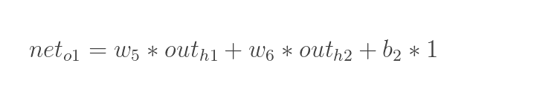
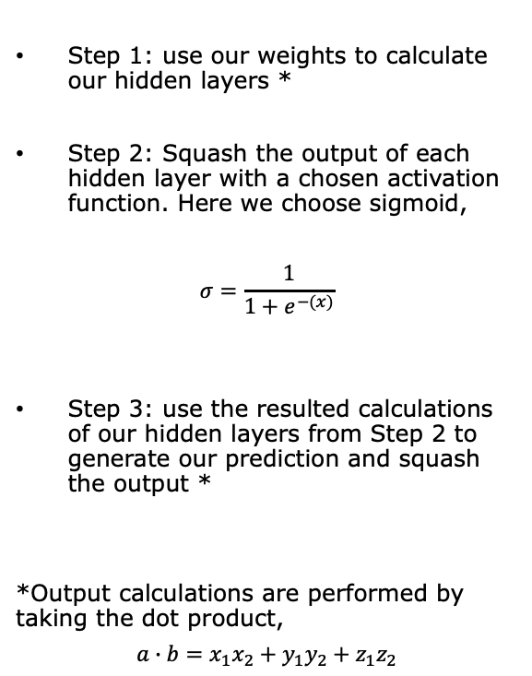
Forward Pass
Step 1: use our weights to calculate our hidden layers *
Step 2: Squash the output of each hidden layer with a chosen activation function. Here we choose sigmoid,
$$σ=\frac{1}{1+e^{−(x)}}$$
Step 3: use the resulted calculations of our hidden layers from Step 2 to generate our prediction and squash the output *
*Output calculations are performed by taking the dot product,
$$a∙b=x_{1}x_{2}+y_{1}y_{2}+z_{1}z_{2}$$

Slide 6
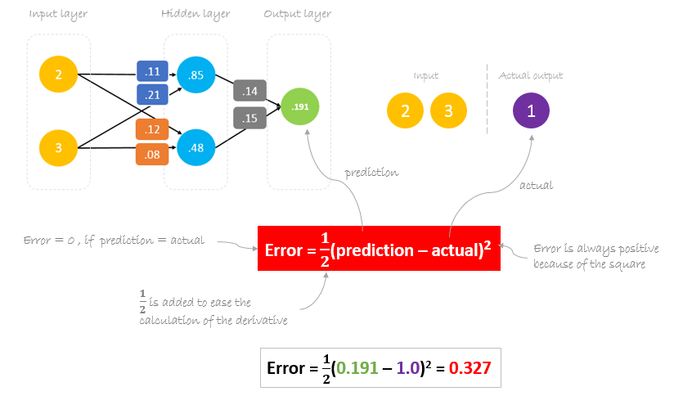
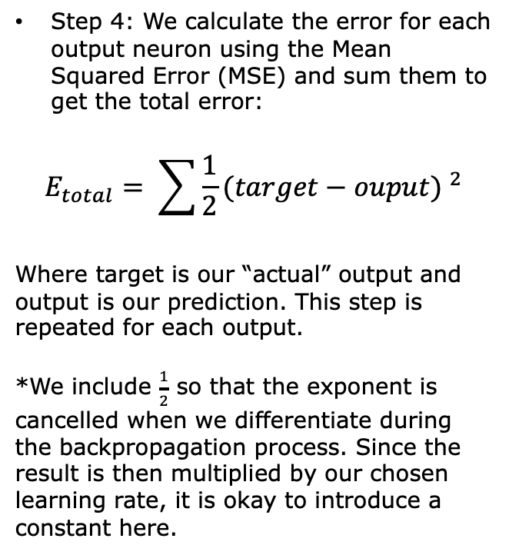
Calculating Error
Step 4: We calculate the error for each output neuron using the Mean Squared Error (MSE) and sum them to get the total error:
$$E_{total}= \sum{\frac{1}{2}}{(target−ouput) }^{2}$$
Where target is our “actual” output and output is our prediction. This step is repeated for each output.
*We include $\frac{1}{2}$ so that the exponent is cancelled when we differentiate during the backpropagation process. Since the result is then multiplied by our chosen learning rate, it is okay to introduce a constant here.

Slide 7
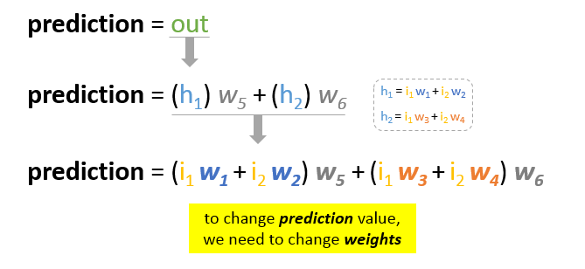
The question now is how to change\update the weights value so that the error is reduced? The answer is Backpropagation!
Reducing Error
is a mechanism used to update the weights using gradient descent. It calculates the gradient of the error function with respect to the neural network’s weights. The calculation proceeds backwards through the network.

Slide 8
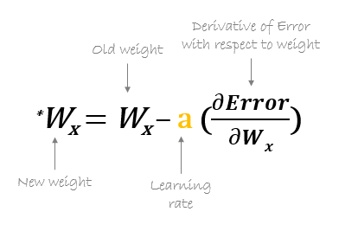

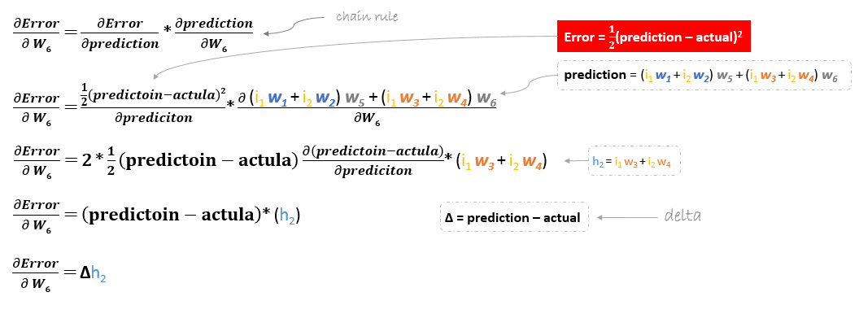
Gradient descent is an iterative optimization algorithm for finding the minimum of a function
Appling the chain rule

Slide 9

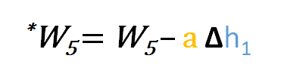
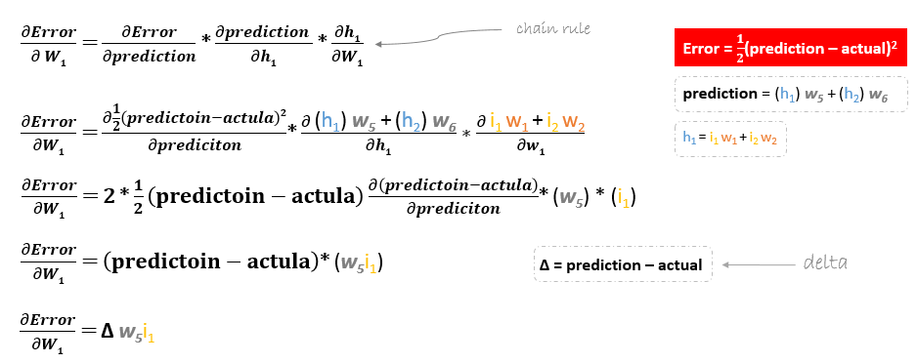
However, when moving backward to update w1, w2, w3 and w4 existing between input and hidden layer, the partial derivative for the error function with respect to w1, for example, will be as following.

Slide 10
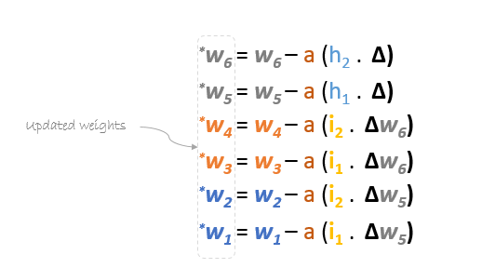
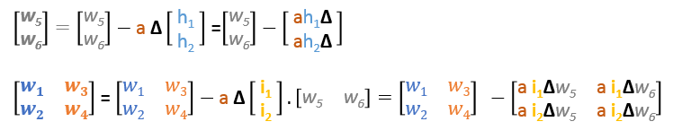
We can find the update formula for the remaining weights w2, w3 and w4 in the same way
We can rewrite the update formulas in matrices as following

Slide 11
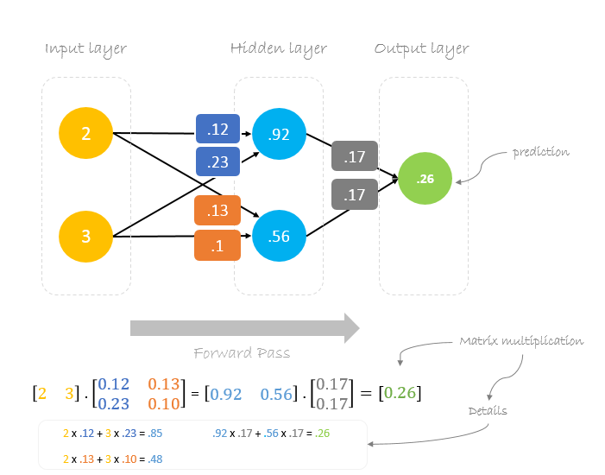
Using the new weights we will repeat the forward passed
We can notice that the prediction 0.26 is a little bit closer to actual output than the previously predicted one 0.191. We can repeat the same process of backward and forward pass until error is close or equal to zero.

Slide 12
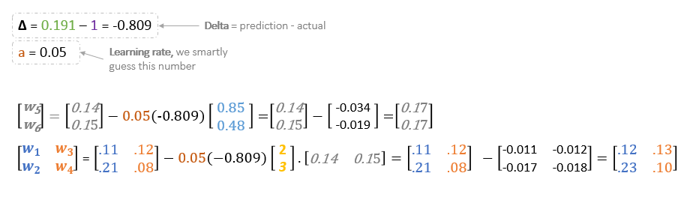
Backward Pass
Learning rate: is a hyperparameter which means that we need to manually guess its value.

Slide 13
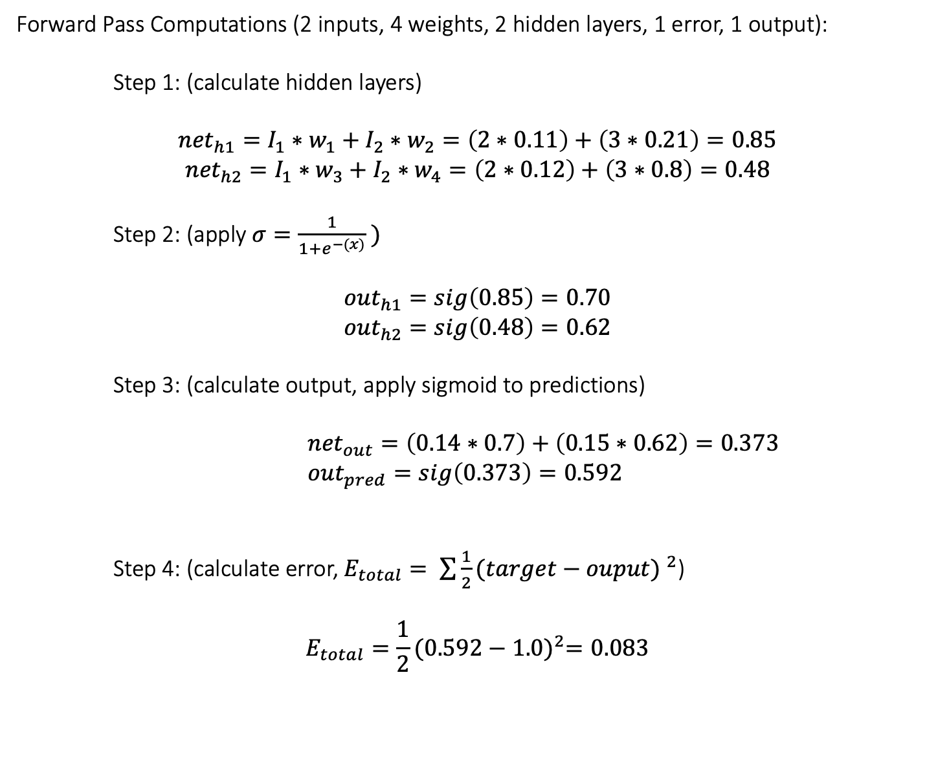
Forward Pass Computations (2 inputs, 4 weights, 2 hidden layers, 1 error, 1 output):
Step 1: (calculate hidden layers)
$${net}_{h1}=I_{1}∗w_{1}+I_{2}∗w_{2}=\left(2∗0.11\right)+\left(3∗0.21\right)=0.85$$
$${net}_{h2}=I_{1}∗w_{3}+I_{2}∗w_{4}=\left(2∗0.12\right)+\left(3∗0.8\right)=0.48$$
Step 2: (apply $σ=\frac{1}{1+e^{−(x)}} )$
$${out}_{h1}=sig\left(0.85\right)=0.70$$
$${out}_{h2}=sig\left(0.48\right)=0.62$$
Step 3: (calculate output, apply sigmoid to predictions)
${net}_{out}=\left(0.14∗0.7\right)+\left(0.15∗0.62\right)=0.373$
${out}_{pred}=sig\left(0.373\right)=0.592$
Step 4: (calculate error, $E_{total}= \sum{\frac{1}{2}}{(target−ouput) }^{2}$)
$$E_{total}=\frac{1}{2}{(0.592−1.0)}^{2}=0.083$$

Slide 14



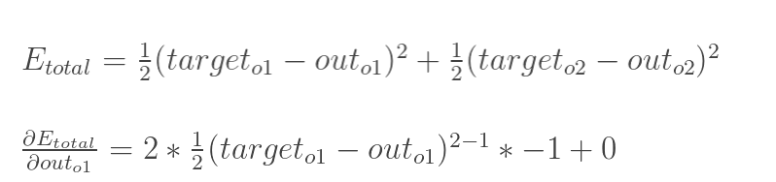
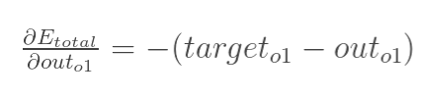
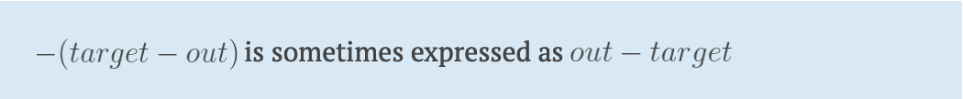
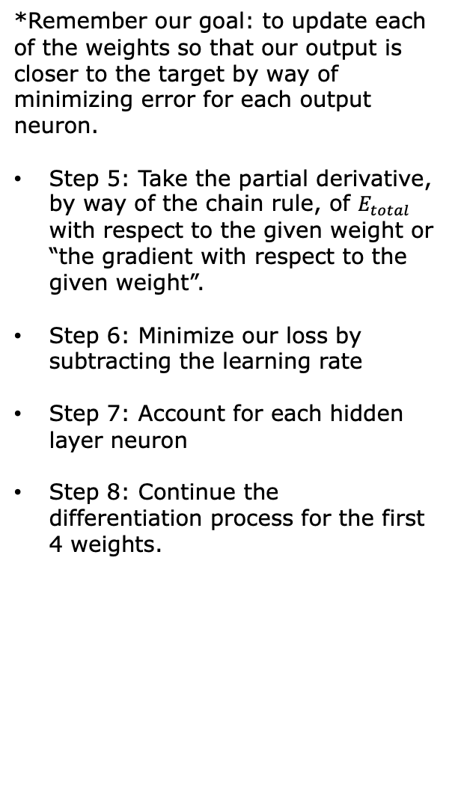
Backward Pass
Breaking Down the Pieces
Total error change with respect to the output:
*Remember our goal: to update each of the weights so that our output is closer to the target by way of minimizing error for each output neuron.
Step 5: Take the partial derivative, by way of the chain rule, of $E_{total}$ with respect to the given weight or “the gradient with respect to the given weight”.
Step 6: Minimize our loss by subtracting the learning rate
Step 7: Account for each hidden layer neuron
Step 8: Continue the differentiation process for the first 4 weights.

Slide 15

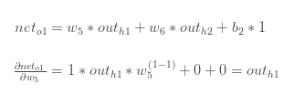

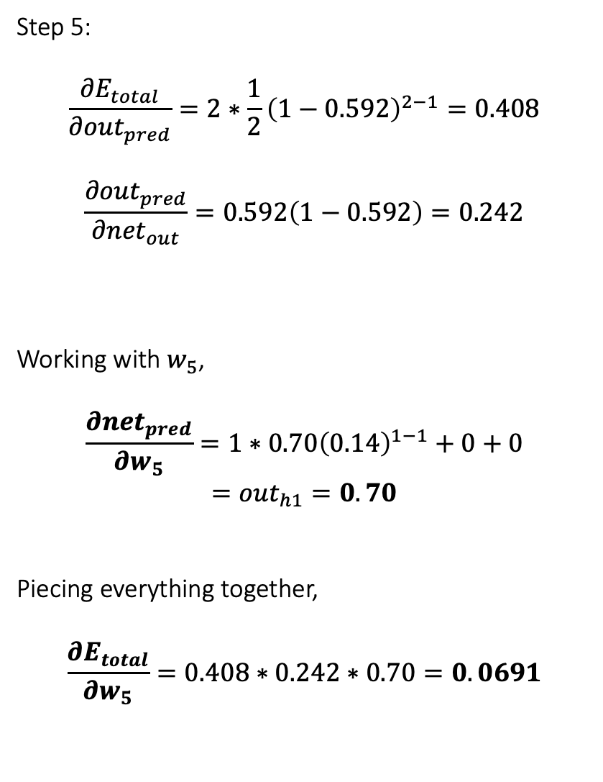
Step 5:
$$\frac{{∂E}_{total}}{{∂out}_{pred}}=2∗\frac{1}{2}{\left(1−0.592\right)}^{2−1}=0.408$$
$$\frac{{∂out}_{pred}}{{∂net}_{out}}=0.592\left(1−0.592\right)=0.242$$
Working with $w_{5}$,
$$\frac{{∂net}_{pred}}{{∂w}_{5}}=1∗0.70{\left(0.14\right)}^{1−1}+0+0$$
$$={out}_{h1}=0.70$$
Piecing everything together,
$$\frac{{∂E}_{total}}{{∂w}_{5}}=0.408∗0.242∗0.70=0.0691$$
How much does the output change with respect to the total net input?
*The partial derivative of the logistic function is the output multiplied by 1-the output
How much does the total net input change with respect to a given weight?
Piecing everything together,

Slide 16

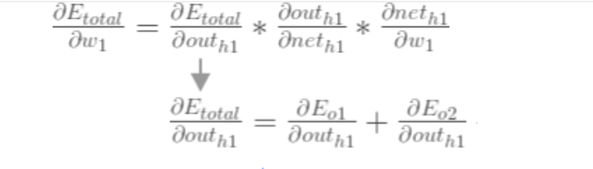





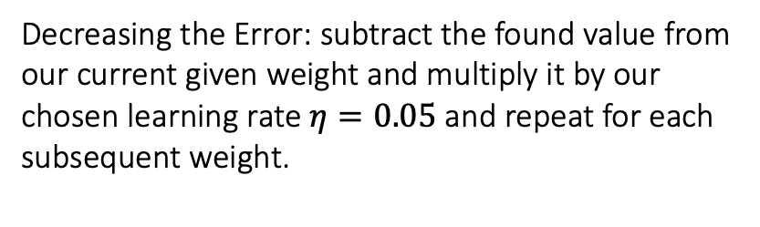
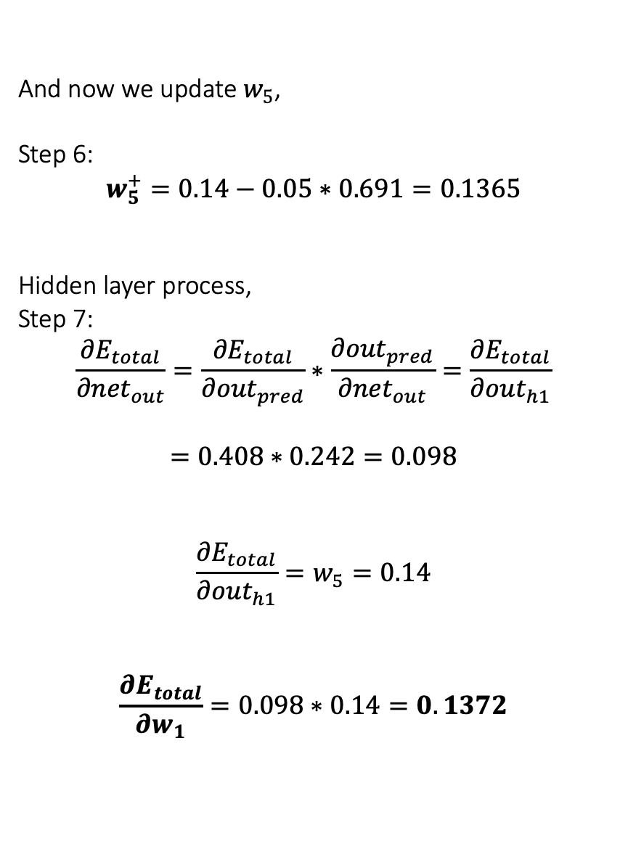
And now we update $w_{5}$,
Step 6:
$$w_{5}^{+}=0.14−0.05∗0.691=0.1365$$
Hidden layer process,
Step 7:
$$\frac{{∂E}_{total}}{{∂net}_{out}}=\frac{{∂E}_{total}}{{∂out}_{pred}}∗\frac{{∂out}_{pred}}{{∂net}_{out}}=\frac{{∂E}_{total}}{{∂out}_{h1}}$$
$$=0.408∗0.242=0.098$$
$$\frac{{∂E}_{total}}{{∂out}_{h1}}=w_{5}=0.14$$
$$\frac{{∂E}_{total}}{{∂w}_{1}}=0.098∗0.14=0.1372$$
Decreasing the Error: subtract the found value from our current given weight and multiply it by our chosen learning rate $η=0.05$and repeat for each subsequent weight.
Hidden Layer: Continue the backward pass by calculating new values for the first four weights.
*Since we only have one error,
this will be our $E_{total}$ .

Slide 17







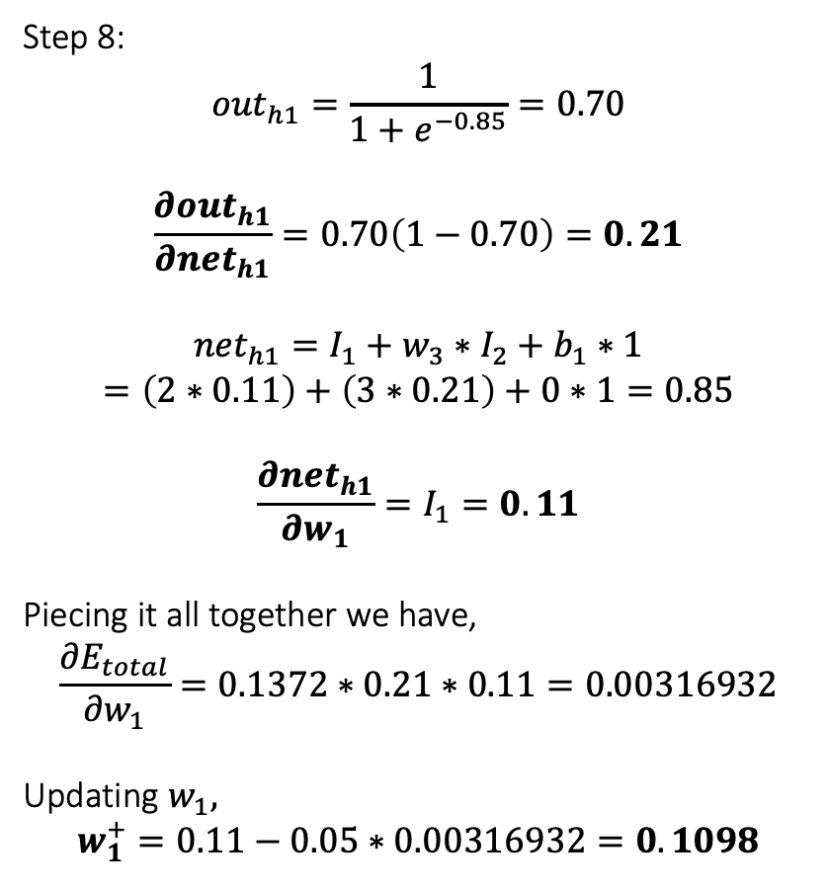
Step 8:
$${out}_{h1}=\frac{1}{1+e^{−0.85}}=0.70$$
$$\frac{{∂out}_{h1}}{{∂net}_{h1}}=0.70\left(1−0.70\right)=0.21$$
$${net}_{h1}=I_{1}+w_{3}∗I_{2}+b_{1}∗1$$
$$=\left(2∗0.11\right)+\left(3∗0.21\right)+0∗1=0.85$$
$$\frac{{∂net}_{h1}}{{∂w}_{1}}=I_{1}=0.11$$
Piecing it all together we have,
$$\frac{{∂E}_{total}}{{∂w}_{1}}=0.1372∗0.21∗0.11=0.00316932$$
Updating $w_{1},$
$$w_{1}^{+}=0.11−0.05∗0.00316932=0.1098$$
Final four weights (we’re almost there!):
We continue by calculating the final two pieces of our equation. We have,
And now we update $w_{1}$,
And repeat the process for $w_{2}, w_{3}, w_{4}$

Slide 18
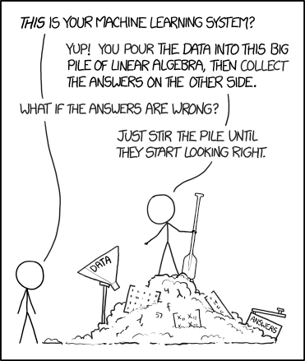
To summarize…
https://xkcd.com/

Slide 19
Backpropagation Visualization
You can build your neural network using netflow.js

Slide 20
References
https://playground.tensorflow.org
https://www.tensorflow.org/tensorboard/
Towards Data Science: Understanding the Backpropagation Algorithm
Assad Moawad's DataThings
MattMazur.com

